Slide 1
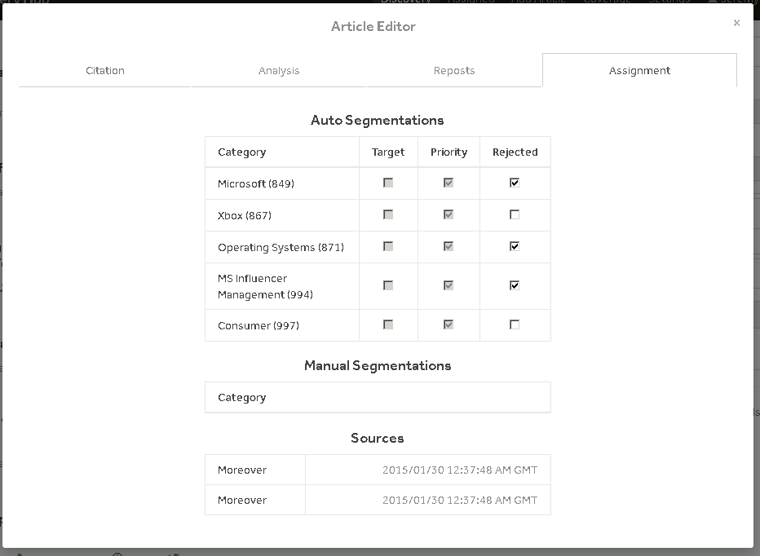
“Checks”
Pros:
Consistent.
Rapid to develop.
Cons:
Difficult to parse quickly.
Requires recall over recognition. Actionable vs non actionable.
meaning of state.
Feedback relies on modal messages (failure, error).

Slide 2
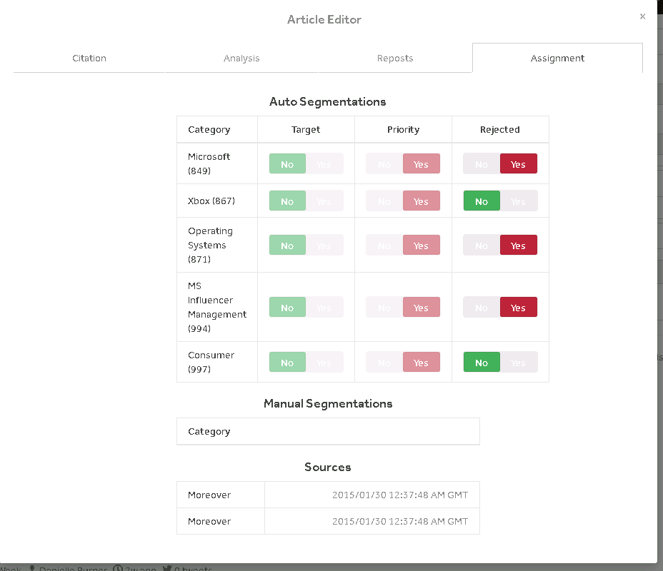
“Switches”
Pros:
Consistent.
Rapid to develop.
Cons:
Easily parsed (color and text)
Requires recall over recognition. Actionable vs non actionable.
meaning of state.

Slide 3
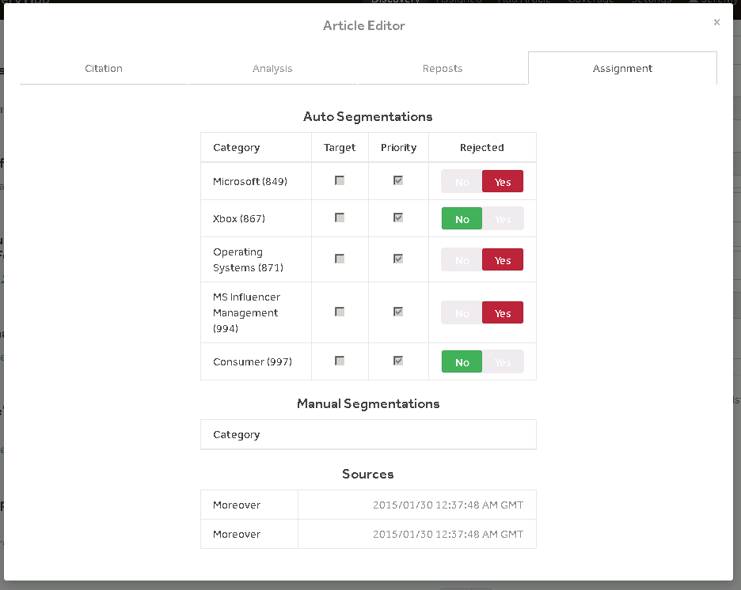
“Split”
Pros:
Visibility of data.
Rapid to develop.
Matches user language
Difference between actionable and informational.
Cons:
Easily parsed (color and text)

